Slide 1
INTRODUCTION TO ICT
Lesson 1 – Introduction and Overview
Copyright by SOICT

Slide 2
Contents
Information and Information Processing
Basic concepts of ICT
Hardware, Software, Network
Copyright by SOICT

Slide 3
Information and Information Processing
Information
Data
Knowledge
Information System
Information Processing
Copyright by SOICT

Slide 4
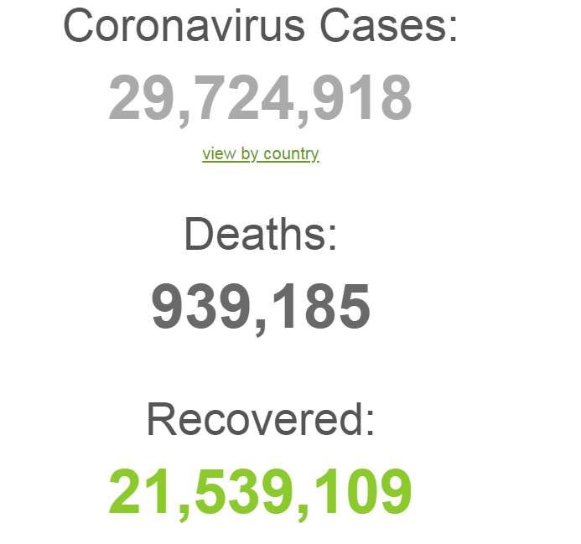
Information
What is information?
  Is an abstract concept describing anything that gives human a better understanding, greater awareness about any subject in social or nature
  Information is something that people can learn, know about, or understand (Wiki)
Copyright by SOICT
Notes:
E.g.:
It was rain yesterday
It is hot today

Slide 5
Data
What is data?
  is a representation of information using physical signal
  Data concept refers to the fact that some existing information or knowledge is represented or coded in some form suitable for better usage or processing (Wiki)
Information has meaning, but data may not?
Copyright by SOICT
Notes:
Information has meaning, but data may not?
Why: Because, sometimes we do not understand, not know, not get any information from a data

Slide 6
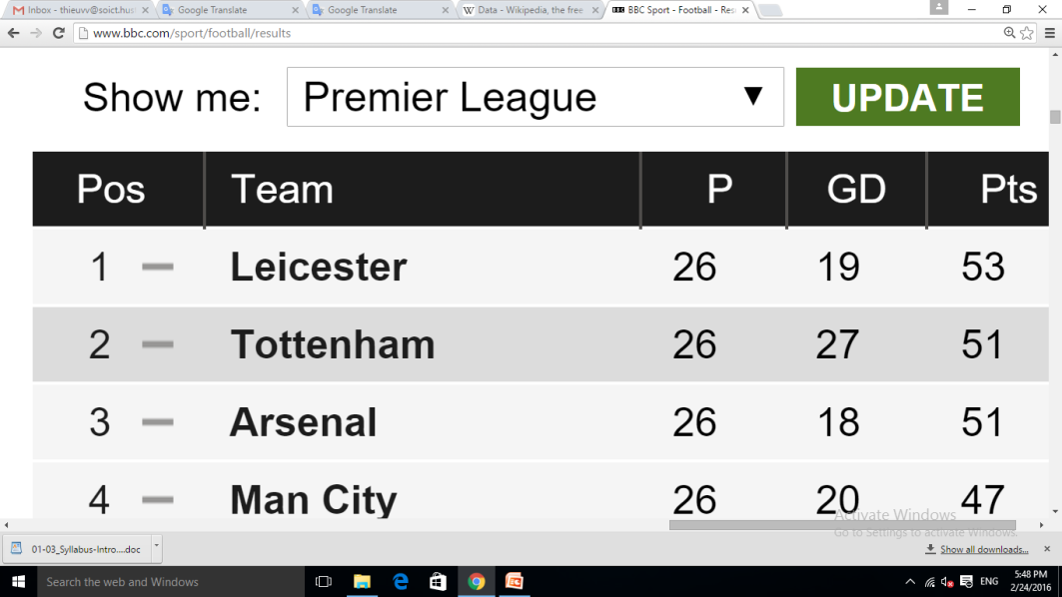
Data
Data can be:
  Symbols
  Numbers
  Characters
  Physical signal: voice, light, temperature, pressure, humidity, wind, …
E.g:
Copyright by SOICT

Slide 7
Question: Information is obtained from data or data is obtained from information?
Copyright by SOICT

Slide 8
Knowledge
What is knowledge?
  Is abstract level of information
  Knowledge is a familiarity, awareness or understanding of someone or something, such as facts, information, descriptions, or skills, which is acquired through experience or education by perceiving, discovering, or learning (Wiki)
Knowledge may be an event or information, or an understanding about things or phenomena in a specific field
Knowledge is obtained from studying or doing experiments
Copyright by SOICT
Notes:
Perceiving: Cảm nhận

Slide 9
Question: Information and knowledge: Which one is obtained from the other?
Copyright by SOICT

Slide 10
Information System
Information system is a system that stores data, processes data to create valuable information or new data
Data
Information
Knowledge
Copyright by SOICT

Slide 11
Information Processing
Input data
Processing
Output data
Storage
Copyright by SOICT
Notes:
IP includes 3 stages: ID, P, and OD. Data is entered at the input, through the processing to receive information in the output. In the process of processing, or inputting/outputting data, we may need memory to store data.

Slide 12
Information Processing
Advantages of Processing Information using computer
    Save time, people
    Increase correctness
    Automation
What are the disadvantages?
Copyright by SOICT

Slide 13
II. Basic concepts of ICT
Informatic
Information Technology
Information and Communication Technology
Copyright by SOICT

Slide 14
Infomatic
“Informatic” concept is first used in 1957 by Karl Steinbuch in the paper ‘Informatik: Automatische Informations verarbeitung’ (i.e. "Informatics: automatic information processing").
In England: ‘Computer science’ or ‘Computing science’ is more popular.
Copyright by SOICT

Slide 15
Infomatic?
What does informatic means:
  is a science that study methods, technologies and techniques to process information automatically.
The main equipments used in informatic are computers and other communication devices.
Informatic consists of 2 parts:
  Hardware engineering
  Software engineering
Copyright by SOICT
Notes:
Hardware engineering: researching and manufacturing of electronic equipment, components, new material technology ... supporting the design and manufacturing of computers and computer networks, promoting processing management and communication.
Software engineering: research and development of operating systems, common utilities for computers and computer networks, application software for different purposes of processing and exploiting information human

Slide 16
Information Technology - IT
Information technology (IT) is the use of any computers, storages, networking and other physical devices, infrastructure and processes to create, process, store, secure and exchange all forms of electronic data
Information technology (IT) is the application of computers and telecommunications equipment to store, retrieve, transmit and manipulate data, often in the context of a business or other enterprise
Copyright by SOICT

Slide 17
Information and Communication Technology - ICT
Information and communications technology (ICT) is often used as an extended concept of information technology (IT).
ICT is a more extensive term (i.e. more broad in scope) that stresses the role of unified communications and the integration of telecommunications (telephone lines and wireless signals), computers as well as necessary enterprise software, middleware, storage, and audio-visual systems, which enable users to access, store, transmit, and manipulate information
Copyright by SOICT

Slide 18
Information and Communication Technology
Applications of ICT:
  In business
  Science
  Technology
  Education
  Medical
  Many other
Copyright by SOICT

Slide 19
III. Hardware, Software, Network
Hardware
Software
Network
Copyright by SOICT

Slide 20
Hardware
Computer hardware is the collection of physical parts of a computer system.
Hardware includes all the parts inside the computer case, such as the hard disk drive, motherboard, video card, and many others.
Computer hardware is what you can physically touch
E.g.?
Copyright by SOICT
Notes:
This includes the computer case, monitor, keyboard, and mouse.

Slide 21
Software
Computer software (also called a program or simply software) is any set of instructions that directs a computer to perform specific tasks or operations.
Computer software consists of computer programs, libraries and related non-executable data (such as online documentation or digital media).
E.g.?
Copyright by SOICT

Slide 22
Network
Developing history
Classification
Basic components
Internet
Copyright by SOICT

Slide 23
Network
A computer network (or network) is a group of computer systems and other computing hardware devices that are linked together through communication channels to facilitate communication and resource-sharing among a wide range of users

Slide 24
Network
E.g:
  Computer network of HUST
  Computer network in Ta Quang Buu Library
  Computer network in a game room
  Internet

Slide 25
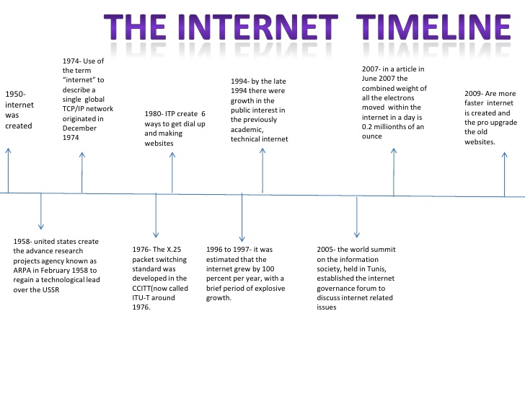

Slide 26
Internet: Classification
By functional relationship
  client-server
  Peer-to-peer
  multitier architecture

Slide 27
Internet: Classification
By range
  Personal area network (PAN)
  Wireless PAN
  Local area network (LAN)
  Wireless LAN
  Metropolitan area network (MAN)
  Wide area network (WAN)
  Global area network (GAN)

Slide 28
Internet: Classification
By network topology
  bus network
  star network
  ring network
  grid network
  tree network

Slide 29
Components of Network
Computers, Network cards
Communication channel
Network equipment:
  Modem
  Hub
  Switch
  Gateway
  Router
  Bridge
  Repeater
Network software:
  Proxy server, Firewall, Network Address Translator,…

Slide 30
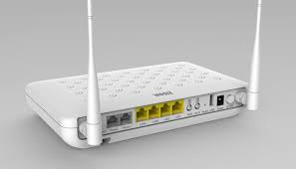
Modem
MoDem: Modulator - Demodulator
Copyright by SOICT
Notes:
The word "modem" stands for "modulator-demodulator". A modem's purpose is to convert digital information to analog signals (modulation), and to convert analog signals back into useful digital information (demodulation).

Slide 31
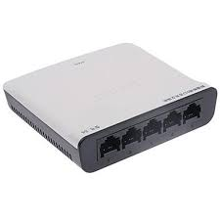
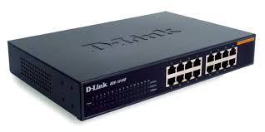
Hub / Switch
A Hub is a networking device that allows one to connect multiple PCs to a single network. Hubs may be based on Ethernet, Firewire, or USB connections.
A switch is a control unit that turns the flow of electricity on or off in a circuit. It may also be used to route information patterns in streaming electronic data sent over networks. In the context of a network, a switch is a computer networking device that connects network segments.
Copyright by SOICT

Slide 32
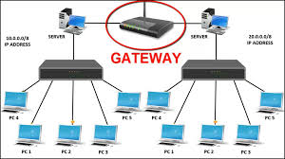
Gateway
A gateway is a network node used in telecommunications that connects two networks with different transmission protocols together. Gateways serve as an entry and exit point for a network as all data must pass through or communicate with the gateway prior to being routed.
Copyright by SOICT

Slide 33
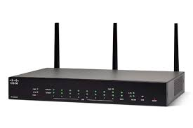
Router
A router is a networking device that forwards data packets between computer networks. Routers perform the traffic directing functions on the Internet.
Copyright by SOICT
Notes:
Gateway compare Router: a gateway is a single point of access to computers outside your network like a door, while a router determines the shortest possible path your data can travel from Computer A to Computer B, like a hallway or a staircase

Slide 34
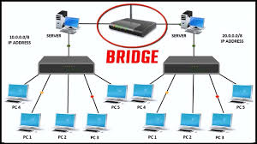
Bridge
A network bridge is a computer networking device that creates a single aggregate network from multiple communication networks or network segments.
Copyright by SOICT
Notes:
Bridging is distinct from routing. Routing allows multiple networks to communicate independently and yet remain separate, whereas bridging connects two separate networks as if they were a single network.

Slide 35
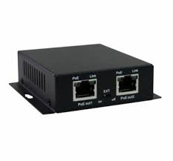
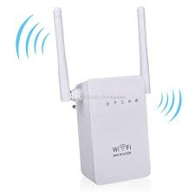
Repeater
A network device used to regenerate or replicate a signal. Repeaters are used in transmission systems to regenerate analog or digital signals distorted by transmission loss
Copyright by SOICT

Slide 36
Internet
Internet is the global communication network that allows almost all computers worldwide to connect and exchange information
Internet is a GAN, consists of all computer networks in the world that are connected by any communication channel

Slide 37
Requirements to connect to Internet
A computer
A modem and a telephone line (if you are using dial up access), or a data line of some sort (if you are not using dial up access)
An Internet browser (software) and software to connect you to the Internet Service Provider (ISP)
An account with an ISP
  The ISP is your gateway to the Internet. You access the ISP over the phone line, and the ISP will connect you to the Internet

Slide 38
Basic services of Internet
Remote login
Data transfer
Email, chat
Network news

